Slide 1

Car resale value prediction

Slide 2
Externship project
Car resale value prediction
V.sai siri reddy(18UK1A05M5)
M.Kavya(18UK1A05N5)
Ch.Mounika(19UK1A0524)
G.Sunitha(18UK1A05J9)

Slide 3
INTRODUCTION
INTRODUCTION
Vehicle price prediction especially when the vehicle is used and not coming direct from the factory, is both a critical and important task. With increase in demand for used cars more and more vehicle buyers are finding alternatives of buying new cars.
There is a need of accurate price prediction mechanism for the used cars. Prediction techniques of machine learning can be helpful in this regard.
It is common to lease a car in many countries rather then buying a new car.

Slide 4
ABSTRACT
A car price prediction has been a high interest research area, as it requires noticeable effort and knowledge of the field expert. Considerable number of distinct attributes are examined for the reliable and accurate prediction.
To build a model for predicting the price of used cars the applied three machine learning techniques are Artificial Neural Network and linear regression.
Respective performances of different algorithms were then compared to find one that best suits the available data set. The final prediction model was integrated into Java application. Furthermore, the model was evaluated using test data and the accuracy of 82% was obtained.

Slide 5
Dataset features
Car brand
Year
Sold price
Present price
Kms driven
Fuel type
Seller
Transmission
Owners

Slide 6
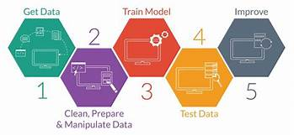
Data collection
For accurate and real time analysis, data is prepared from scratch.
Data is collected from ‘Kaggle.com’.

Slide 7
Data preprocessing
Data preprocessing is a process of preparing the raw data and making it suitable for a machine learning model. It is the first and crucial step while creating a machine learning model.
When creating a machine learning project, it is not always a case that we come across the clean and formatted data. And while doing any operation with data, it is mandatory to clean it and put in a formatted way. So for this, we use data preprocessing task.

Slide 8
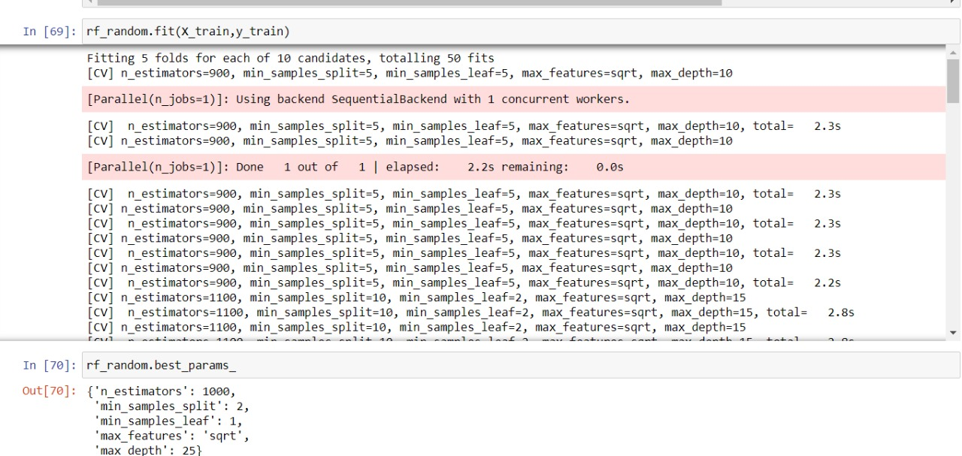
Train test split
The train test split technique can be used for classification and regression problems to test machine learning algorithms. The procedure takes the given dataset and splits it into two subsets:
Training dataset: it is used to train the algorithm and fit the machine learning model.
Test dataset: Using the input element from the training data, the algorithms make predictions.

Slide 9
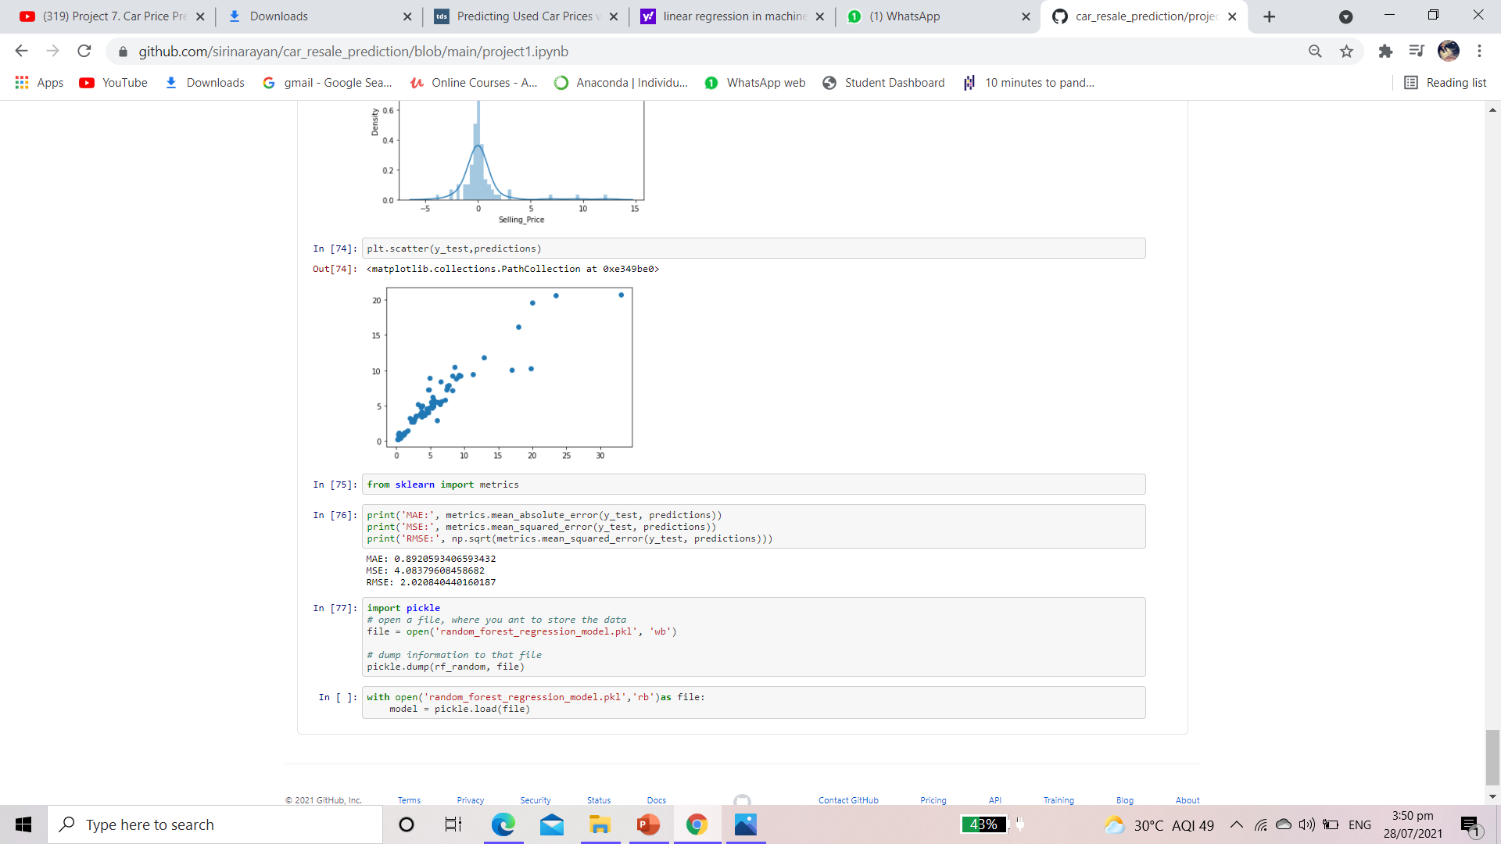
Linear regression
Linear regression is one of the easiest and most popular Machine Learning algorithms. It is a statistical method that is used for predictive analysis.

Slide 10
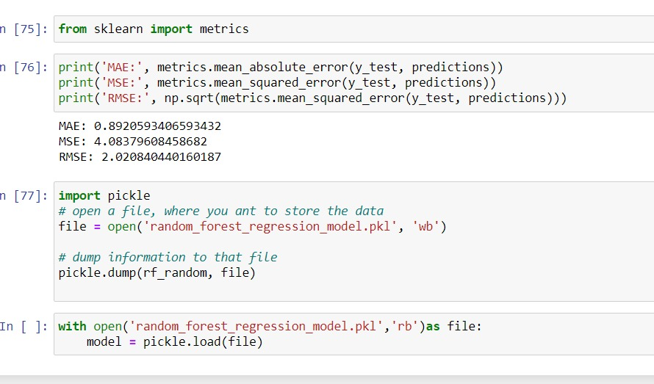

Trained linear regression

Slide 11
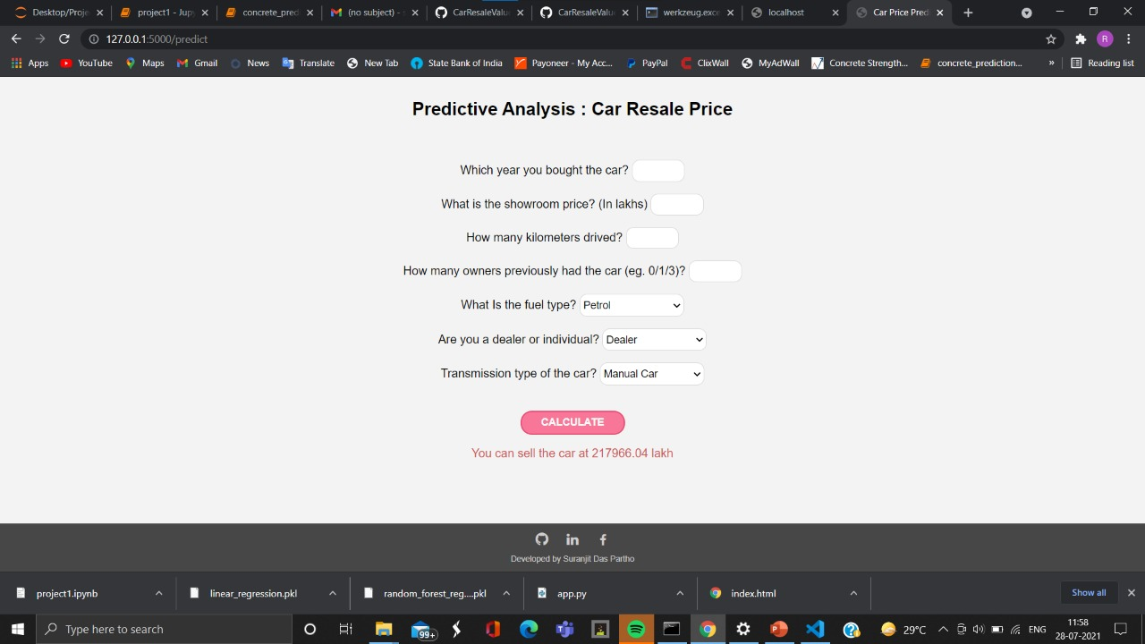
Our prediction output

Slide 12


